Slide 1
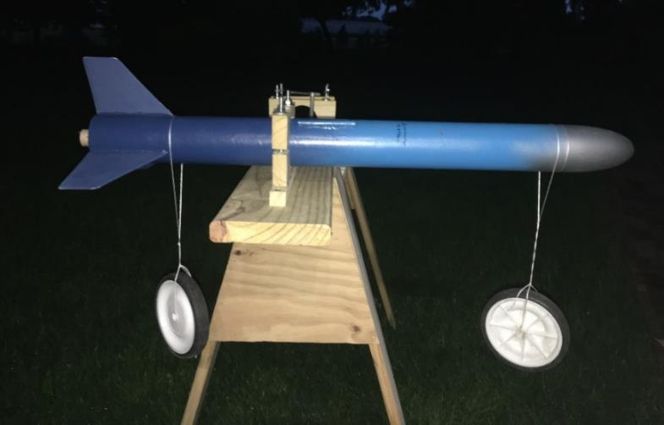
Build Your Own Rocket Lab
LabRat Scientific
© 2018

Slide 2
What will your School Board allow?
Do you need to stick to commercial model rocket kits?
  You can still accomplish neat stuff
Will you be allowed to design/build your own rockets?
  Do you understand the liability?
  Analysis and ground test will be essential for a safe program
Will you be restricted to D-Rocket Motors or less?
  You will need to get an NAR certification for anything over a G-motor

Slide 3
What will your School Board allow?
Safe flight operations are CRITICAL
  Maybe you can participate in regional high powered rocketry meets instead of launching on your own
    Sanctioned meets tend to have reasonable safety practices
    May be insured
    Usually have large fields and big buffer between rockets and participants

Slide 4
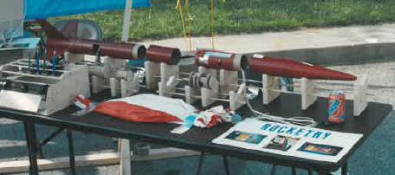
Scratch-built rocket using common, low cost materials
Tail Section
Telemetry Section
Battery Section
Parachute Ejection Section
Nose Cone
This entire rocket system (rocket, telemetry, recovery system) was built from scrounged and inexpensive materials

Slide 5
If you are allowed to build custom rockets…
You must at least do the following before flight:
  Run a theoretical analysis, but don’t rely on the results as absolute truth. Compare results to some basic testing
  Theory might say a rocket will work, but theory does not address fabrication workmanship, and remember, when running simulations, “junk in” results in “junk out”
  Ensure motor mount is strong enough
  Ensure fins will remain attached
  Ensure design is stable
    Via Analysis and Pre-Flight Test
  Ensure rocket body is sufficiently stiff/strong
  Ensure recovery system will survive the deployment environment
  FAA rules must be followed (weight, materials, airspace, etc.)
  Have adequate field to launch from (Launch Range)
  NEVER, NEVER, NEVER build your own rocket motors

Slide 6
Benefits of having a Rocket Program
Touches on many STEM disciplines
  Math (geometry, algebra, calculus, etc.)
  Physics
  Mechanical Design and Fabrication (real hands-on stuff)
  Electronics
  Computer Programming
    Students can develop their own simple simulation software
Setting up a lab is a great learning experience
  What equipment is needed
  How are appropriate tests developed
  How are tests and analyses proven adequate or accurate
Students can participate in the design and construction of test equipment
Learn how to “test” and demonstrate why it is important
Hands-on and real-world
  Design, build, test real stuff… Its not just a paper exercise

Slide 7
Elements of a Challenging Rocket Program
Design
  Payload
    For added educational benefit your rockets should be used to collect some sort of data
      Engineering data on the rocket itself
      Atmospheric data
  Flight Simulations
    Trajectories
    Stability
  Thrust and Fin Load Calculations
Fabrication
  Tools required depend on materials used
    Cardboard, balsa, model plywood, plastics
Testing
  Motor mount load tests
  Fin load tests
  Stability tests
    Swing test for smaller rockets
    Wind tunnel
  Parachute tests
Flight
  Safe operations
  Collect data
Post Flight Analysis
  Did the rocket behave like you thought?

Slide 8
Aerodynamic Testing

Slide 9
Aerodynamic Testing
Stability Testing
  The most important aerodynamic test…
  An unstable rocket can be dangerous
  A wind tunnel test or a swing test should be used to verify any theoretical analysis
Drag Measurement
  Drag measurements are not critical to safe rocket flight
    If your drag estimate is incorrect, the rocket will either fly higher or lower…
  A wind tunnel is generally the best way to determine rocket drag

Slide 10
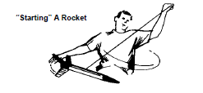

Swing Test
The “poor man’s” wind tunnel
A swing test can be used for small to moderate sized rockets. This test has limitations – as rockets grow, inertial forces begin to affect the results…
Build up the rocket as if you were going to launch it. It must have the rocket motor, recovery system, and payload installed so the CG is in the flight configuration. Hang the rocket from the CG…

Slide 11
Buy or Build a Wind Tunnel
Commercial Option
  Commercial educational wind tunnels can be expensive ($6,000 +)
  Commercial educational wind tunnels tend to have good load measurement systems, but the size of the test articles can be limited
Home Built Option
  Can be built for a fraction of the cost of a “fancy” commercial version. Commercial versions need to “look good”, thus cost more…
  A design could be based on 1 – 4 commercial ventilator fans
  Plywood construction with 2x2 framing and 2x4 legs
  Simple mechanical load measuring devices can be built
  Get your shop classes to build it as a project…

Slide 12
Key Wind Tunnel Design Points
Use rat wire screen to keep people from sticking body parts in the fan blades – safety is critical
Industrial ventilator fans can be loud so it may not be practical to have a home built wind tunnel in the classroom
  Set up in the automotive shop? Set up outside – cover with a tarp when not used? Put it on wheels and roll it outside for use?
Flow velocity can be increased by having a large area for the fans then reducing the cross-sectional area of the test section
The trick is to get a nice linear airflow
  Suck the air through the tunnel to reduce flow circulation – rather than blow through…
  Use flow tubes between the test section and fans to reduce flow circulation. Christmas wrapping paper core tubes make excellent thin walled flow straighteners
  A stick with a long, narrow streamer can be used to assess the flow quality

Slide 13
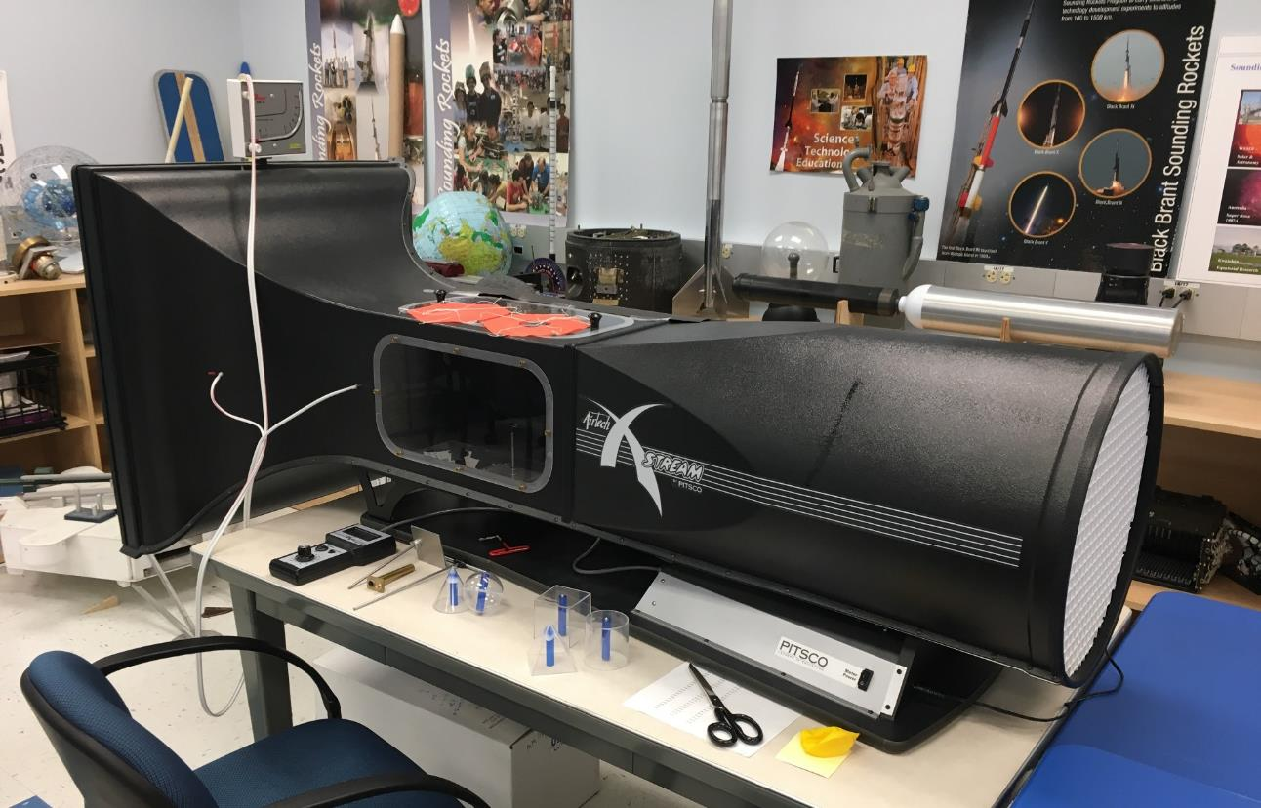
Commercial Educational Wind Tunnel
Air flow

Slide 14
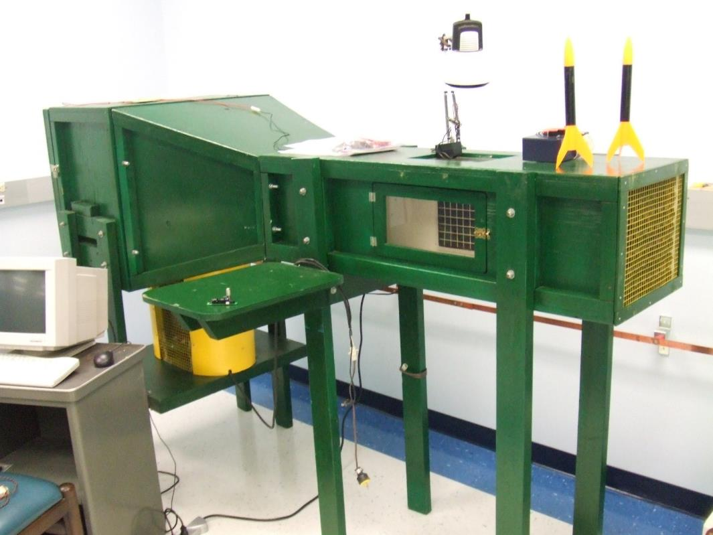
Home-Built Educational Wind Tunnel
Air flow

Slide 15
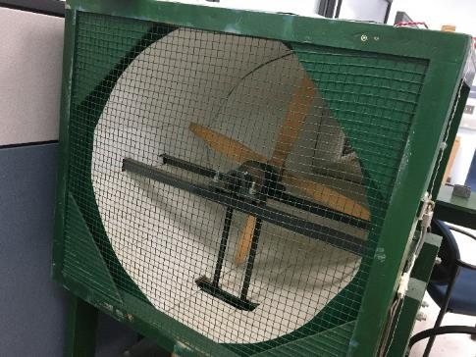
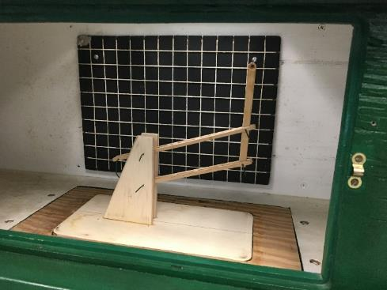
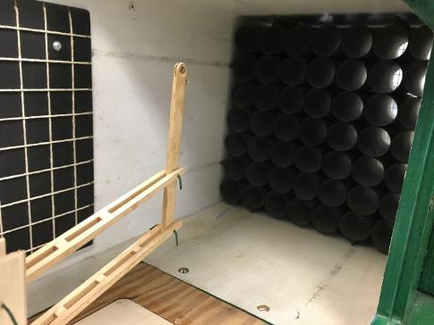
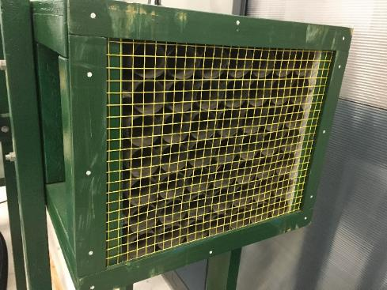
Home-Built Educational Wind Tunnel
Rat wire mesh protecting spinning propeller. Electrical interlock cuts power to the propeller if door is opened. Door has a lock.
Mechanical lift measuring mechanism
Internal view of flow straightener tubes (inlet end)
External view of flow straightener tubes (inlet end)

Slide 16
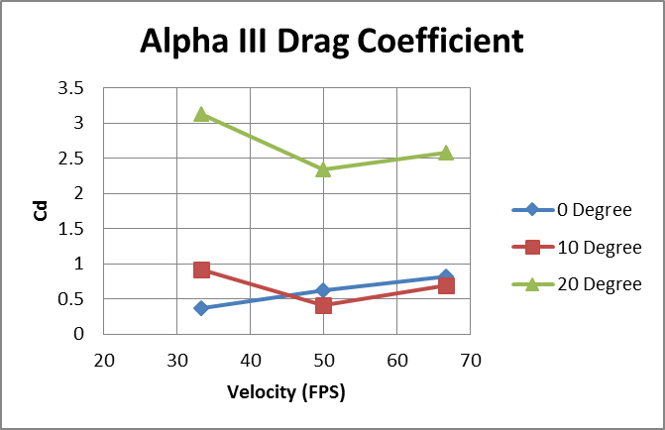

Slide 17
Structural Testing

Slide 18
Motor Mount Testing
The motor mount transfers the thrusting force to the rocket skin/structure
Inadequate gluing of the motor mount can lead to a rocket failure – especially when flying rockets with heavy electronic payloads
A reasonable load test value: 2 x Maximum Thrust (for the biggest motor that can be used in the rocket)

Slide 19
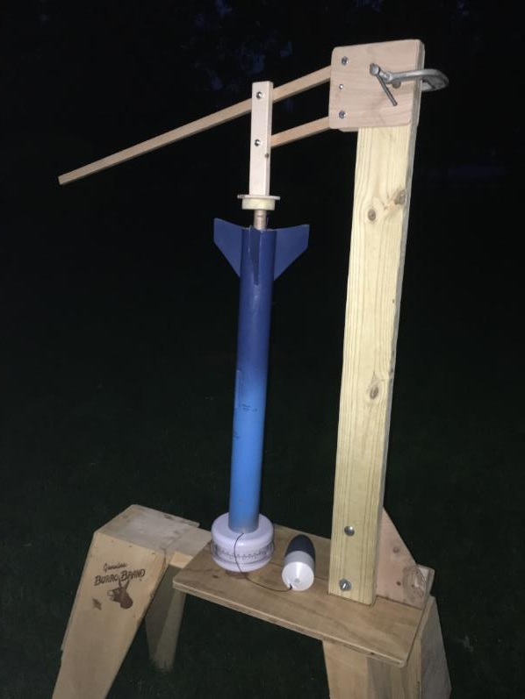
Motor Mount Load Test Rig
Parallelogram load applicator. Mechanism is height adjustable and held in place using a C-clamp.
Scale – in this case, a 5 lb capacity kitchen scale

Slide 20
Fin Loading
Fins generate lift and this lift puts a bending load on the fin mounting (where it is attached to the body tube). If a poor gluing process is used or the fin material is too thin, the fins could break off, causing the rocket to go unstable.
As the rocket pitches back and forth, the fin lift changes direction. This action wrenches the fin back and forth at the fin root.

Slide 21
Fin Load Testing
Strap holding rocket body (hose clamp from hardware store)
Fixture is secured to a table using C-clamps
Test weight:
As a general rule of thumb (to be safe), the test weight needs to be 2x the expected maximum aerodynamic bending load (calculating the load is the hard part)

Slide 22
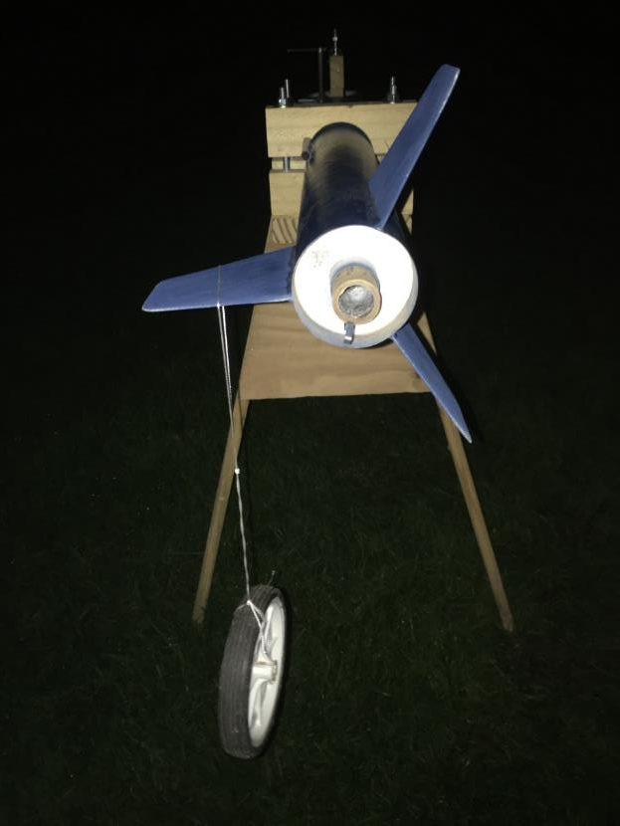
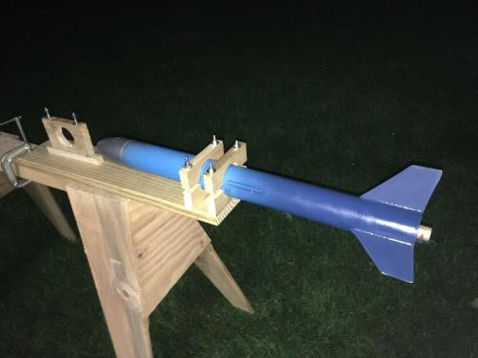
Fin Load Test Rig
Clamp to hold rocket. (or you could just get little Timmy or Sally to simply hold the rocket…)
Test Load

Slide 23
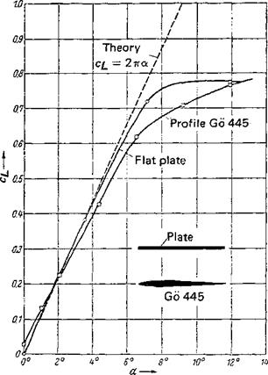
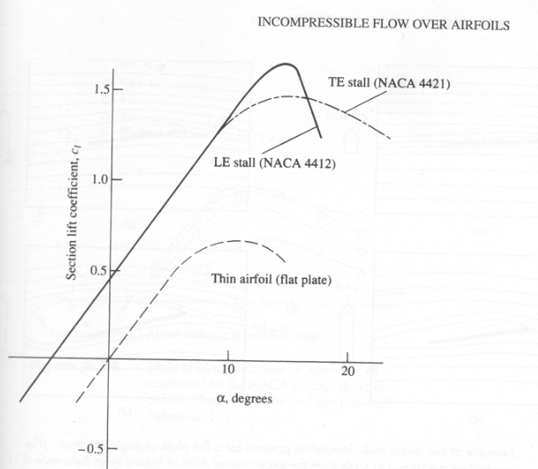
Estimating Fin Lift
The lift coefficient (C_{L}) depends on the angle of attack (angle with the airflow). For a reasonably stable rocket an angle of attack of 2 deg. can be assumed.
From the two data plots above, the C_{L} is approximately 0.2 for a “flat plate” (which is a good approximation for a model rocket).

Slide 24
Is a 2 degree angle of attack a reasonable assumption?

Slide 25
Sample Calculation
Lift = ½ x Air Density x Velocity² x C_{L} x Fin Area
Air Density = 0.00237 lb*sec²/ft⁴
Velocity = Maximum velocity of the rocket (Ft/Sec)
C_{L} = Lift coefficient of the fin design (unitless)
Fin Area = Plan form area of a single fin (Ft²)
WRATS Rocket Fin: Area = 9.75 in² = 0.068 ft²
Lift = 0.5 x 0.00237 lb*sec²/ft⁴ x (300 ft/sec)² x 0.2 x 0.068 Ft²
Lift = 1.5 lbs

Slide 26
Loading the Fin
The lift acting on the fin creates a moment about the point where the fin is attached to the rocket. Assume the lift acts at a point 2/3 out along the fin span. Hang the test weight at 66% Span with weight equal to twice the calculated lift.
66% Span
Lift
Test Weight = 2 x Lift
66% Span
Make sure you test all of the fins…

Slide 27
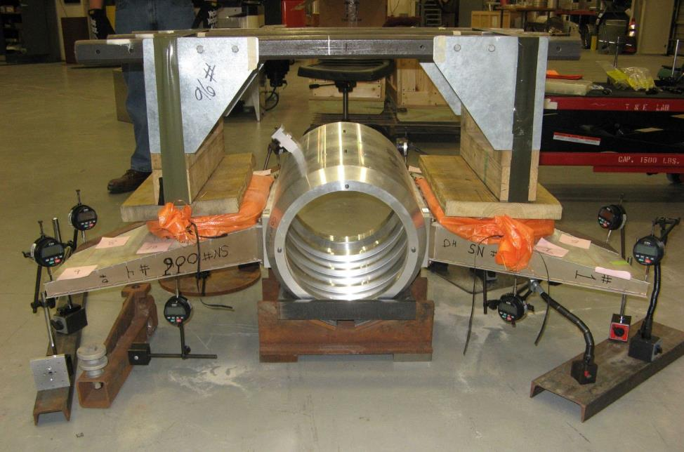
Sounding Rocket Fin Load Test
Weights were placed on the frame which is resting on top of the fins. A weight equivalent to a mini van was placed on top...

Slide 28
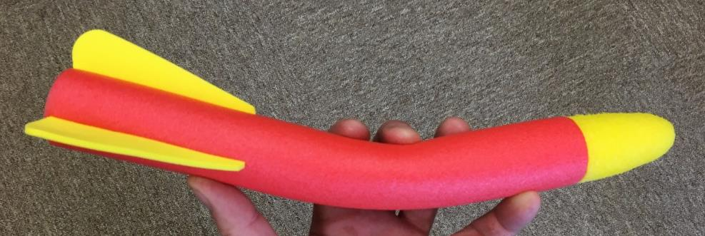
Rocket Bending
The nose and fins of the rocket generate lift. This lift makes the rocket fly like a banana. If the banana bends too much, the rocket could become unstable or break in half.
Fin Lift
Nose Lift
This is not usually a problem for a typical model rocket, but if you begin building larger rockets with multiple sections mated together, then bending could become an issue…

Slide 29
Nose and Fin Lift
Fin Lift:
Fin lift was described earlier. Use the same approach to calculate the fin lift, but now you need to double the lift (assuming a 4 fin rocket) since two of the fins are actually contributing to the restoring moment that makes the rocket stable.
Applicable Fin Lift = 2 x Lift of Single Fin
To provide safety margin and to account for unknowns and assumptions, multiply the Applicable Fin Lift by 2 (two) to determine the Test Load.
Using our earlier fin calculations, the Test Load is:
Test Load = 1.5 lbs x 2 fins x 2 safety factor = 6.0 lbs

Slide 30
Nose and Fin Lift
Nose lift due to the curved shape and angle of attack
Angle of Attack
Assume the Lift Coefficient for an Ogive nose cone is 0.3 (unitless).

Slide 31
Nose and Fin Lift
Nose Lift:
Nose lift is calculated in a similar manner as the fins. The only difference is the “area” that is used. The area is the cross-sectional area, (a.k.a. reference area) of the nose cone when viewed from the aft end.
Lift = ½ x Air Density x Velocity² x C_{L} x Ref Area
Air Density = 0.00237 lb*sec²/ft⁴
Velocity = Maximum velocity of the rocket (Ft/Sec)
C_{L} = Lift coefficient of the fin design (unitless)
Ref Area = Area of the base of the nose cone (Ft²)
Sample Ref Are: Pi x (Radius)² = 3.1614 x (1.5 in.)² = 7.1 in² = 0.049 Ft²
Lift = 0.5 x 0.00237 lb*sec²/ft⁴ x (300 ft/sec)² x 0.3 x 0.049 Ft²
Nose Lift = 1.0 lb

Slide 32
We should apply our safety factor of 2 (two) once again. Our Test Load becomes:
Test Load = 1 lb x 2 = 2 lb
Our banana rocket is now subjected to the two bending loads.
6.0 lbs
2 lbs

Slide 33

Bend Test
Hang the weights on the body tube at the base of the nose cone and right in front of the fins. These are not the exact positions of the lifting loads, but our safety factor (x2) allows us to get away with the approximation…
If the rocket doesn’t sag or break in half, it should be OK.
The rocket is held at the CG which is where the forces act around…
2 lbs
6.0 lbs

Slide 34
Recovery System Testing

Slide 35
Parachutes
It’s good to know the drag coefficient of the parachute, but atmospheric conditions (wind turbulence and thermals) will make the parachute deviate quite a bit from the theoretical descent
  Parachute drift distances can be estimated by calculating the descent time and multiplying by the average wind velocity
  Ft (drift distance) = Sec (chute descent time) x Ft/Sec (wind speed)
  The parachute must be able to withstand the deployment loads
    Will suspension lines stay attached to the canopy?
    Is the shock attenuation system (elastic cord) adequate to dissipate the opening loads?

Slide 36
Parachute Drop Test
Attach a test weight to the parachute – you need to know this weight accurately
  Keep the weight as light as possible so it can be assumed that the parachute reaches terminal velocity right away (i.e. very quickly).
Drop the parachute from a high point – at least 20 ft high
  Use an in-door stairwell or balcony to avoid wind effects
  Keep away from walls so the parachute will descend unobstructed
Do not fold the parachute. Hold the parachute from its apex then drop. This will allow the parachute to open as quickly as possible.
Perform a number of tests to get an idea of when the parachute is fully open. Is this 15 feet, 10 feet, or some other height above the floor?
  This height will represent the fall distance under terminal velocity. The velocity of the parachute will be determined by taking this distance (ft) and dividing it by the time it takes to hit the ground (sec).

Slide 37
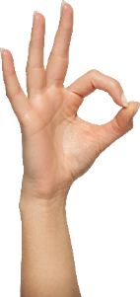

Parachute Drop Test
Initial Drop
Falling Parachute
Full open – second or so after release…
Terminal velocity achieved – a second or so after full open…
Make your best approximation of this distance
Distance / Time = Ave Velocity

Slide 38
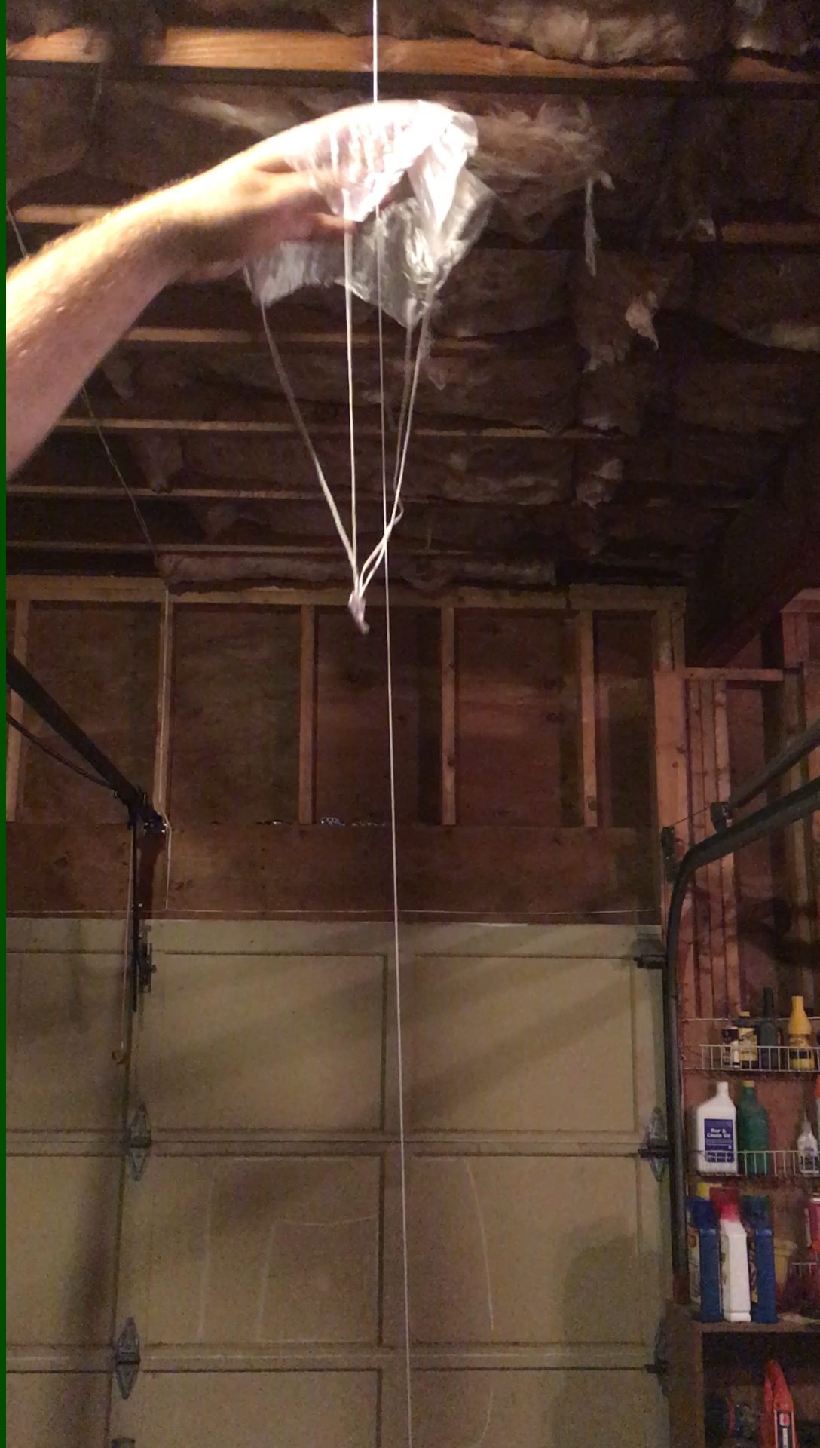
Guide line keeps the chute from drifting to the side and hitting obstructions
Fishing line would make a good guide line due to low friction
Be careful not to allow the suspension lines to drag along the guide line
Allow the chute to descend for several feet before entering the timing zone (allow chute to get to terminal velocity)
Maximize the length of the timing zone to reduce influence of start/stop reaction time
The longer the timing zone, the more influence friction will have on the results
Video

Slide 39
Drag Coefficient Calculation
2 x Weight
Cd = -----------------------------------------------------------
Air Density x Velocity² x Canopy Area
Weight = Weight hanging from the parachute
Velocity = Average velocity measured from the test
Air Density = 0.00237 lb*sec² / ft⁴
Canopy Area = Calculate based on the chute design
Is this value anywhere close to the baseline value for your parachute shape? If not, have your students try to come up with reasons…
As was discussed in an earlier lesson, the Cd and system physical parameters can be used to determine the descent time for your rocket.

Slide 40
From looking at the video it appears that maybe there was some friction between the test article and the guide line.
While the results were not horrible, enhancing the test set up should result in even better values.
A larger chute dropped over a longer distance should help offset frictional forces…
A 1/10 sec start/stop reaction time variation can have a noticeable effect on the results.
The learning point – how to develop a good test set-up…

Slide 41
Build a Parachute Wind Tunnel
If you are really gung-ho, you can build a simple vertical wind tunnel to test your parachutes…
Load Cell, diet scale, or simple weight balance
Test Article
Flow Straighteners
Keeps air flow from swirling
Made from paper towel tubes
Simple Box Fan
Top View
Legs
Suck air through the wind tunnel to get less turbulent airflow…

Slide 42
Parachute Opening Load Testing
A parachute system is useless if it fails during deployment. A simple test should be conducted to make sure the shock attenuation system is adequate and the suspension lines stay attached to the canopy.
An “infinite mass” deployment test can be conduced using a deployment wand and some sort of vehicle. “Infinite Mass” means that the system will not slow down after the chute deploys. This means the parachute will have to survive the loads for a relatively long period of time. In reality, the rocket will slow down quickly after the chute deploys.
How to get the necessary speed:
A running person might be able to get to a speed of 9 ft/sec
A bicycle rider can maybe reach 22 ft/sec
A golf cart or car can reach higher speeds…
CAUTION: Only adults should be allowed operate a vehicle due to potential liability issues…

Slide 43
Opening Load Test Wand
Cap
PVC Tube
Vehicle Motion
Air Flow
Test Parachute
Not recommended for large parachutes – loads will jerk the wand out of your hands…
Strong pole (3 ft long)
Release String
A passenger must operate the device. Do not speed… Do not use on public roads…
Pull to Release

Slide 44
Speed Conversion Table
Ft/Sec | M/Sec | MPH
10 | 3 | 7
20 | 6 | 14
30 | 9 | 20
40 | 12 | 27
50 | 15 | 34
60 | 18 | 41
70 | 21 | 48
80 | 24 | 55
Select parachute ejection delay times that deploy the parachute a second or two after apogee. This will keep the velocity within approx. 50 fps and reduce opening loads.
Caution: Drag load increases with the Square of the Velocity. Start at a low speed to gain a feel for the resultant loads. Do not exceed a safe load…

Slide 45
Mass Properties Testing

Slide 46
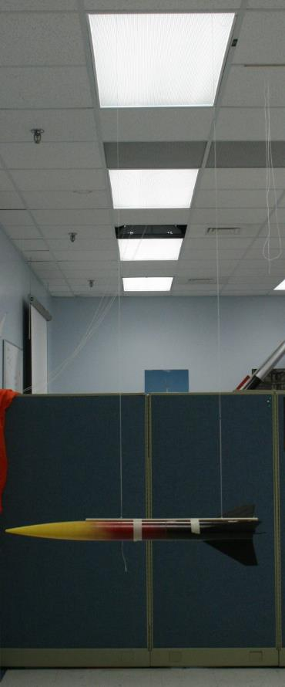
Moment Of Inertia (MOI) Measurement
A simple Bifilar Pendulum (two stings hanging from the ceiling) can be used to measure roll and pitch inertia.
Roll inertial will govern how the rocket spins. Pitch inertia will affect how the rocket responds to wind gusts.
These properties are needed to predict the 3rd, 4th, 5th, and 6th degrees of freedom in a true rocket simulation…
length
dist

Slide 47
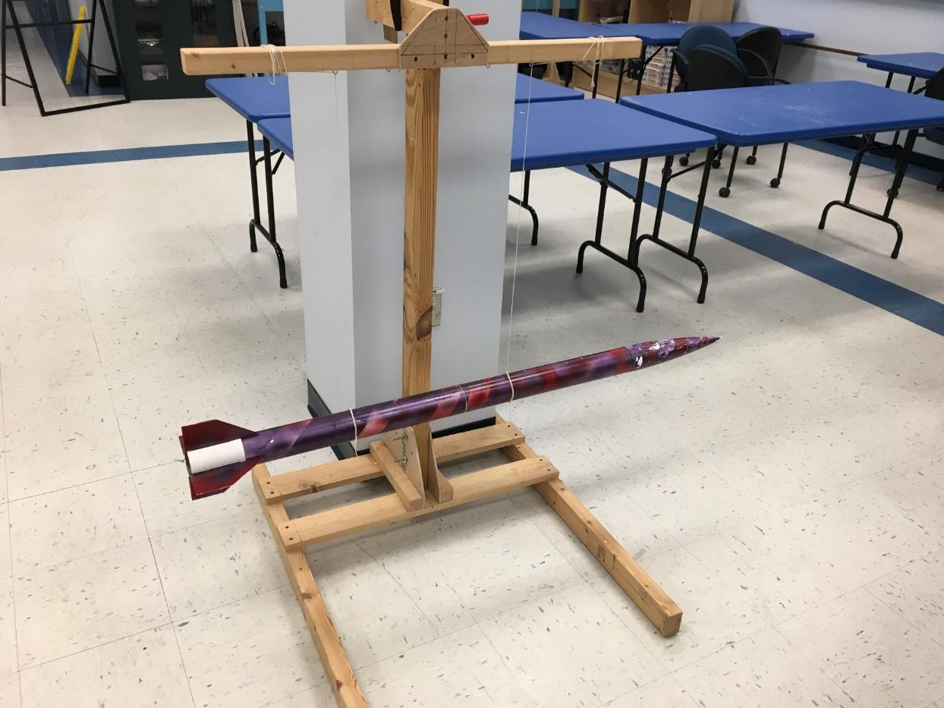
MOI Test Stand

Slide 48
Moment (dist² x weight x period²)
of = ---------------------------------------------
Inertia (16 x pi² x length)
Where:
dist = distance between the strings (Feet)
weight = the weight of the test object (Lbs = slugs x 32.2 ft/sec²)
period = time it takes the pendulum to make one complete oscillation (Sec)
length = length of the strings suspending the object (Feet)
Pi = 3.1417

Slide 49
Let’s do some quick Unit Analysis…
Moment (ft² x slug x ft/sec² x sec²)
of = ---------------------------------------------
Inertia (16 x pi² x ft)

Slide 50
Let’s do some quick Unit Analysis…
Moment (ft² x slug )
of = ---------------------------------------------
Inertia ( )
So, the units of Moment of Inertia are Slug-ft²

Slide 51
Effects of Moment of Inertia
A rocket with a higher moment of inertia will react to wind gusts slower
  Less wind sensitive (less wind cocking)
Oscillations (once they occur) will take longer to damp out
  Can result in higher average angle of attack over the course of the flight, and thus result in higher drag
  Higher drag tends to result in lower apogee
Resulting pitch rate could match the spin rate and the rocket could enter into roll/pitch coupling
  Results in even higher angle of attack
  Could lead to rocket break up

Slide 52
Assessment of our Model Rocket
Configuration | Pitch MOI (Slug*Ft²) | Pitch MOI (Kg*m²)
OpenRocket Theoretical | 0.0121 | 0.0164
Measured (Bifilar Pendulum) | 0.0079 | 0.0108
This represents a 35% error… Which one should we believe?

Slide 53
Theoretical calculation of Block MOI
The block’s CG will be at the middle of the block
We can use a homogeneous block to test the accuracy of the Bifilar Pendulum. A wood 2x4 serves as a good test article.
The following equation can be used to calculate the Moment of Inertia (MOI) about the block’s CG:
1
MOI = ------- Mass x ( W² + L² )
12
= 0.08 x 0.89 Kg x [( 0.04 m)² + (0.51 m)²]
= 0.08 x 0.89 Kg x 0.26 m²
MOI = 0.0185 Kg * m²
CG
L
W
Mass = 0.89 Kg
W = 0.04 m
L = 0.51 m

Slide 54
Bifilar Pendulum Measurement of Block MOI
Using the Bifilar Pendulum Equation:
D (m)² x W (Kg*m/sec²) x Period (sec)²
MOI = ----------------------------------------------------------
16 x Pi ² x L (m)
(0.46 m)² x (0.89 Kg* 9.8 m/sec²) x (1.8 sec)²
MOI = ----------------------------------------------------------
16 x 3.1416² x 2.0 m
0.21 m² x (0.89 Kg* 9.8 m/sec²) x 3.2 sec²
MOI = ----------------------------------------------------------
16 x 9.9 x 2.0 m
5.86 Kg*m²
= ------------------- = 0.0185 = MOI
316.8
L = 2 m
D = 0.46 m
M = 0.89 Kg
Trial | Time (sec for 4 oscillations) | Period (sec)
1 | 7.2 | 1.8
2 | 7.2 | 1.8
3 | 7.3 | 1.8
4 | 7.4 | 1.9
5 | 7.2 | 1.8
Average Period = 1.8

Slide 55
Assessment of Block Comparison
For the wooden block test case:
Theoretical: 0.0185 Kg * m²
Measured: 0.0185 Kg * m²
So, the bifilar measurement matches a simple physical case that can be easily calculated…
In this instance, which rocket value do you believe?

Slide 56
Assessment
We know how we have derived the experimental MOI…
Mass, lengths, distances, and time need to be measured accurately
Bad data = bad experimental results
Without examining the computer code, we do not know how the program calculates the MOI
Is the method precise or just an approximation?
The accuracy of the input data will affect the results
Did you build the rocket with the exact materials assumed by the OpenRocket code?

Slide 57
Something to consider:
Do the fins on the rocket affect the period of the oscillation?
Maybe an interesting experiment for the classroom…

Slide 58
Rocket Motor Testing

Slide 59
Rocket Motor Performance
We can rely on the published thrust curves for the rocket motors that we use in model rockets, but there is much to be learned from attempting to measure the thrust.
More complex (and costly) rocket motor test stands rely on load cells and data recoding devices. Is it possible to develop a simple qualitative test stand using something almost everyone has – a cell phone?

Slide 60
Motor Test Stand
We can build a device that uses gravity as a spring. This device is a pendulum test stand. Its cheap and easy to build…

Slide 61

Motor Test Stand
We can build a device that uses gravity as a spring. This device is a pendulum test stand. Its cheap and easy to build…

Slide 62
Trigonometry of the System
We are going to have to use some math to determine how much the table will move (rise) for a given amount of horizontal force applied…
Needed Force
Dead Weight
Opp Needed Force
Tan ( ) = ------------ = ---------------------
Adj Dead Weight
“Needed Force” is the force needed to deflect the table a certain angle ( )
Needed Force = Dead Weight x Tan ( )

Slide 63
Looking at Extreme Deflections…
Opp
Tan (ang) = ---------
Adj
Ang = 90
Platform Weight
Ang = 45
Ang = 0
Horizontal force needed to keep the Platform Weight pushed all the way up = infinity (impossible)
Platform Weight
Platform Weight
Force = Platform Weight x Tan (Ang)
Horizontal force needed to push the Platform Weight slightly upward = very small (essentially 0)
Tan (0 deg) = 0
Tan (90 deg) = Infinity

Slide 64
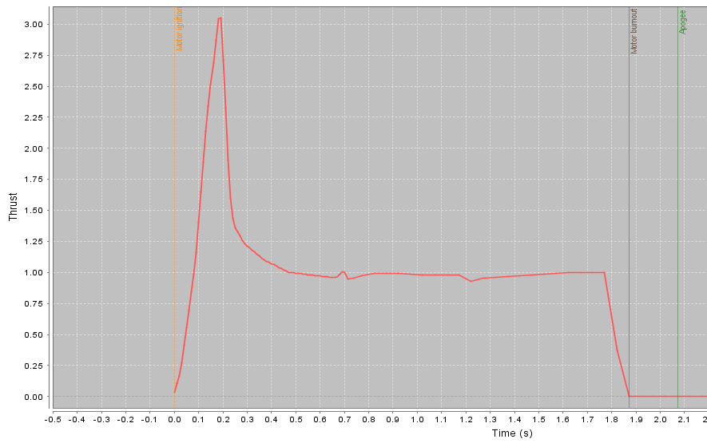
Estes C-6 Rocket Motor
Boost Thrust
(lbs)
Sustainer Thrust

Slide 65
Spreadsheet to determine the necessary dead weight (platform weight) for the type of rocket motor being tested
Reasonable angle considering the design of the test stand
Adjust the Dead Weight until the maximum thrust occurs at 50 deg deflection
Max thrust of the C6 rocket motor

Slide 66
Pendulum Test Stand Calibration
Shortly after ignition the table should deflect ~ 50 deg. (boost phase)
During the sustainer portion of the burn, the table displacement should drop back to ~ 21 deg.
This calibration curve is based on a 2.5 lb dead weight

Slide 67
Data Reduction from Test #2 Video Data
Published
Burn Out
The measured thrust level matches the published thrust cure pretty good as it climbs to the peak level (3 lbs), but the time doesn’t match real well… Then, after the thrust drops back to the sustainer level (~ 1 lb), inertial forces and the lack of damping causes issues… The burnout time can be determined…
How can this be rectified?

Slide 68
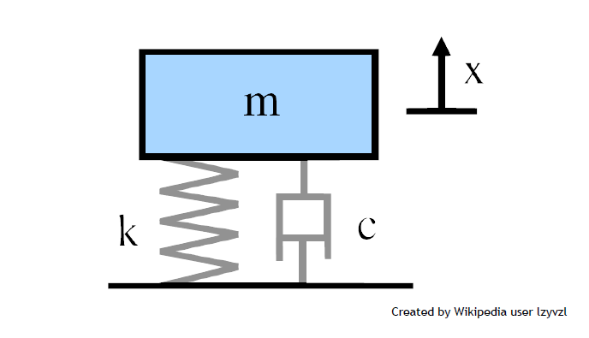

Thrust
Gravity
Damping
Damping is a function of “velocity”. Generally, you want higher damping when the velocity is high, and lower damping when velocity is low

Slide 69
Are you itching to get home so you can start working on your own rocket lab?

